Slide 1
Fuzzing with AFL
Michael Macnair
@michael_macnair

Slide 2
Agenda
Intro to fuzzing and AFL
Exercise – fuzz a toy program
Practical fuzzing with AFL
Challenges
Tips, target selection, limitations
Resources
Challenges continue

Slide 3
Not Covering
History of fuzzing
Fuzzing without source
Network fuzzing
Target specific techniques
Architecturally complex targets (e.g. kernel)
Any tools other than afl (and a bit of libFuzzer)
Running at scale
Crash triage
Current research

Slide 4
Background: flaws
Software: f(input) -> output
Applies at any scale: PowerPoint, grep, the Linux kernel, a library, a class, a function, a snippet of code.
Sometimes, f(unexpected_input) -> security flaw

Slide 5
Background: finding flaws
Finding if there are any inputs that cause security issues is difficult.
Design review, code review, static analysis, dynamic analysis, …
Dynamic analysis: run program on input, check it doesn’t violate your constraints.
Fuzzing
Simplest constraint: doesn’t crash.
Random inputs
Surprisingly effective!
Notes:
Input selection –
Fuzzing: inputs that are potentially unexpected, perhaps syntactically or semantically invalid

Slide 6
Background: fuzzing steps
Fuzzing steps:
Pick a target
Identify fuzzing attack surface
Pick a fuzzing tool (or write your own)
Make your target and tool work together
Fuzz until done
Triage the results
Focus of this
workshop
Notes:
Targets - program, library, single API, bit of hardware, …
Will cover a little bit of target selection

Slide 7
Background: who/why?
Who fuzzes?
Developers, to create secure / robust software
Consultants / researchers / bug-bounty hunters performing vulnerability assessments
Attackers, prior to exploit development
(Curious people, for fun)
(CTF players, for points)
Notes:
Mandated in Microsoft SDLC for parsers
Attaclers could be the nasty type or the bug bounty type

Slide 8
What fuzzing is good for
Finding crashes that can be triggered by input
Running lots of tests that you never would
Examples:
PDF readers; graphics; office suites; ..
libraries (images; audio; ...)
perl, clang, gcc, sqlite, ...
browsers
Unix tools: strings, file,
Crypto APIs, filesystem drivers, …
OS kernels
Notes:
Use After Free bugs – hard to spot with manual code review in complex codebases
What’s it not good for?
* Finding logical security flaws that you aren’t explicitly checking for. E.g. privilege escalation, an unpriv user can carry out some privileged action – fuzzing won’t tell you unless you have some test that checks for this situation.
* Testing for known bugs – just run the testcase. But if that doesn’t crash it doesn’t mean the fix is perfect – just that it no longer triggers on this input.
* Also see the Non-Targets slide at the end

Slide 9
American Fuzzy Lop
a security-oriented fuzzer that employs a novel type of compile-time instrumentation and genetic algorithms to automatically discover clean, interesting test cases that trigger new internal states in the targeted binary.
Ubiquitously known as ‘afl’

Slide 10
Why afl?
The best general purpose fuzzer
For C/C++/Objective C programs
Effective
Fast – lots of test cases per second
Clever – test cases are well chosen
Easy to use
(see also: libFuzzer)
Notes:
Easiest to use on Linux, but can be used elsewhere

Slide 11
What does afl do?
Instrumentation guided fuzzer
Compiler instruments code
AFL learns code path taken for a given input
Genetic algorithm - mutates inputs that hit new code paths*
* technically new tuples of basicblock-basicblock
Skips entries that provide a subset of coverage
Probabilistically skips unfavoured entries
Slow / large
Various mutation strategies - deterministic + random
Dictionaries to help with magic values
Pragmatic:
The tool can be thought of as a collection of hacks that have been tested in practice, found to be surprisingly effective, and have been implemented in the simplest, most robust way I could think of at the time.

Slide 12
Workshop Environment
Your own container, dedicated cores
Editing options:
Terminal – nano, vim, emacs
Local + scp/rsync
Local + git (fork the repo, push/pull)
Visual Studio Code (Insiders) – Remote SSH
Alternatives:
Local docker: docker run –privileged -it -u fuzzer mykter/afl-training /bin/bash
On host: git clone https://github.com/mykter/afl-training.git
Notes:
https://code.visualstudio.com/insiders/
scp –P
docker run --volume

Slide 13
Practical 1
Taking afl for a spin
ssh fuzzer@<IP> –p 305NN
IPs:
1.2.3.4
Ports: 30500 – 305xx
Password: <TODO>
Instructions in
workshop/quickstart/README.md
Notes:
sch-copy-id –p 305nn fuzzer@ip

Slide 14
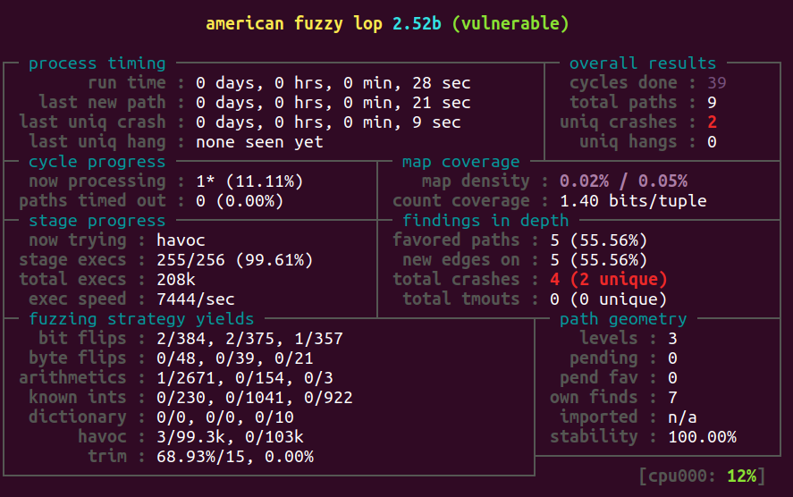
Status screen
Notes:
See docs/status_screen.txt
Map density purple is a warning – see the docs (in this case not a problem as the target is really simple)
Important ones: last new path; crashes; exec speed; total execs; cycles done (colour); cpu utilization

Slide 15
Practical 1
Walkthrough
What did afl find?
Why?
What if you didn’t have the head seed?
How might we find the easter egg?
Notes:
Head / easter egg:
Read your target’s documentation
Find/harvest an existing input corpus
strings
Byte-by-byte memcmp

Slide 16
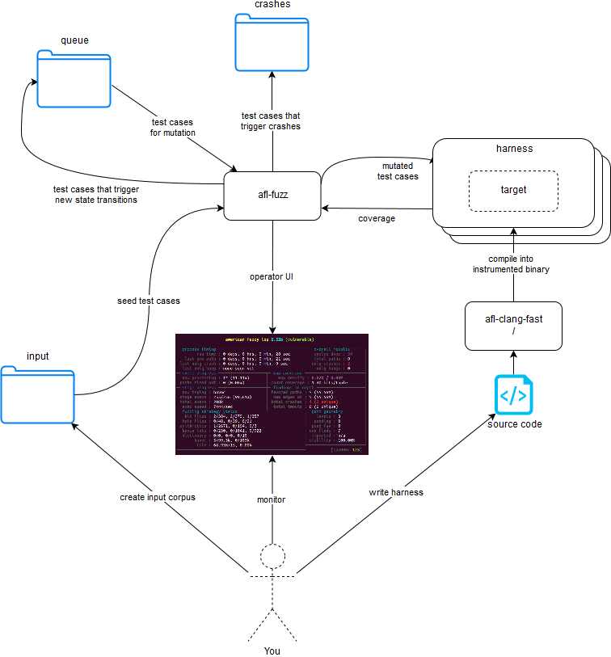
Notes:
The main components and the most important interactions between them.
Original diagram is in the harness/ folder of the repository.

Slide 17
Test Harnesses
Create a harness that will:
Run in the foreground
Usefully process input on stdin (or a specified file)
Feed input to your target: whole program (maybe you just modified its main function), or specific API, or function, or code snippet
Exit cleanly
Crash on an error, if going beyond crashes
(skip checksums + cryptographic integrity tests)
Use afl’s deferred forkserver + persistent mode
Notes:
There is an exercise that walks you through this in harness/
Be careful with deferred forkserver + persistent mode – only use it if you’re confident that there isn’t persistent state that will change between runs and undermine the algorithm.

Slide 18
Documentation
docs/
In particular
life_pro_tips.txt
README
../llvm_mode/README
Notes:
If you’re spending any significant time fuzzing, worth reading it all. But don’t let that put you off going with the quickstart – this course is more than enough to find real bugs!

Slide 19
LLVM Mode
Deferred forkserver: tell afl where to start each new process
Especially useful for processes with an expensive setup phase that isn’t dependent on input
Persistent mode: don’t fork for each run, just loop around this bit of code
Especially useful for fast targets
llvm_mode/README

Slide 20
Initial Test Cases
(aka seed corpus)
Don’t waste core-weeks trying to synthesise your target’s input format
Find some real inputs that exercise as much of the target as possible.
From the README:
Keep the files small. Under 1 kB is ideal, although not strictly necessary.
Use multiple test cases only if they are functionally different from each other. There is no point in using fifty different vacation photos to fuzz an image library.
Notes:
The quickstart exercise highlights how much of a difference this can make.
Awesome example of corpus synthesis without seeds: https://lcamtuf.blogspot.com/2014/11/pulling-jpegs-out-of-thin-air.html

Slide 21
Sanitizers & Hardening
Spot things you otherwise wouldn’t
Inputs that lead the code to do bad things that don’t crash
UBSan, MSan, ASan, TSan
AFL_HARDEN=1
Mutually incompatible
Run most fuzzers with AFL_HARDEN
Run a small number with each sanitiser
Notes:
Some special considerations when using ASAN with afl. Easy to enable – AFL_USE_ASAN when compiling – but with 64 bit executables need some help, see docs/notes_for_asan.txt
AddressSanitizer (ASan):
Out-of-bounds accesses to heap, stack and globals
Use-after-free
Use-after-return (runtime flag ASAN_OPTIONS=detect_stack_use_after_return=1)
Use-after-scope (clang flag -fsanitize-address-use-after-scope)
Double-free, invalid free
Memory leaks (experimental)
(2x slowdown)
MemorySanitizer (MSan):
Uses of uninitialized memory
(3x slowdown)
Use -O2 and don’t use FORTIFY_SOURCE
UndefinedBehaviourSanitizer (UBSan), e.g.:
Using misaligned or null pointer
Signed integer overflow
Conversion to, from, or between floating-point types which would overflow the destination
Thread Sanitizer:
Detects data races
5-15x slowdown; 5-10x memory overhead

Slide 22
Parallel Fuzzing
Not as frictionless as the rest of afl
Necessary for high performance
Multicore
One master (–M) instance, one slave (–S) per core
Pretty easy
On the cloud instance: taskset –c <cpunum> afl-fuzz…
Multi machine
Lots and lots of slave instances
Script to sync state directories periodically
ClusterFuzz
Notes:
afl-gotcpu can tell you if you’ve got spare cores
On the cloud instance, cgroups limits which CPU cores your container can access. AFL isn’t aware of this, so we disable its automatic core detection via AFL_NO_AFFINITY, and use taskset to pin a fuzz job to a core. The core numbers your instance has access to are indicated in the hostname.
ClusterFuzz is the first production-grade open source fuzzing infrastructure. Runs on GCP.

Slide 23
Dictionaries
afl-fuzz -x my.dict
Help the fuzzer to access paths it otherwise wouldn’t
Get them from:
dictionaries folder
libFuzzer’s collection
libtokencap
subdir in afl, creates a dictionary by intercepting calls like strcmp and memcmp.
Useful for identifying head in quickstart!
Source code review (/grep)
Notes:
afl automatically collects dictionary style entries in out/queue/.state/auto_extras/

Slide 24
Practical 2
Read and optionally run through the harness/ tutorial
Recommended challenge order
libxml2
heartbleed
sendmail/1301
ntpq
date
cyber-grand-challenge
sendmail/1305
Go!
Regardless of what you attempt, do read all the README.md, HINTS.md, and ANSWERS.md files for the different challenges

Slide 25
Beyond memory corruption
Add asserts to detect bad things, e.g.:
Send input into two different math/crypto libraries and asserts that their output is identical
assert that result of BN_sqr(x) == BN_mul(x,x) - CVE-2014-3570 in OpenSSL
assert if any filesystem changes have occurred – CVE-2014-6271 in Bash (shellshock)

Slide 26
Misc Tips
Network targets
Ideally write a harness around the target function (e.g. the parser)
Use inetd mode if your target supports it
Intercept network system calls, e.g. using preeny
Disable checksums
The queue directory contains a corpus of test cases that exercise your program
Run it through CoverageSanitizer or gcov – see what isn’t hit
Integrate into CI, check for no crashes
More?
Resume a fuzzing run with -i- (robust, not quick)
Notes:
https://clang.llvm.org/docs/SourceBasedCodeCoverage.html

Slide 27
Triage Tips
ASan traces can be helpful
afl-tmin to minimise and simplify test cases whilst retaining the original control flow
“Unique” bugs are not unique! Fix ones you can and repeat.
Memory limits can give false positives
Scripting helps with lots of crashes (collect stdout/stderr; run with different sanitizers; get a gdb backtrace; …)

Slide 28
When To Stop
Never? Fuzz as part of continuous integration
When the cycles counter is green
Last new path was found many cycles ago
Pending paths is zero
If you want to stop earlier:
Cycles counter is blue (=> last new path was over a cycle ago)
It’s been running for a while (hours + millions of executions + at least 2 cycles)
Look at the output of afl-plot
Remember to check code coverage
Notes:
Environment variable AFL_EXIT_WHEN_DONE will cause afl to exit instead of the cycle counter turning green. Could be useful in a CI line?

Slide 29
Limitations: fuzzing
Hard to tell when to stop
Tests the target in the exact configuration you provided, on the input source you set up
Can get stuck (e.g. checksums)
Only notices problems that can be automatically detected

Slide 30
Limitations: afl
Crashes only*
Typical of most fuzzers
stdin / file input only*
Linux/OSX only*
Need to build target from source*
Gets stuck on magic values*
Basic-block instrumentation won’t guide it towards all crashes
x=1/(input – 1234)
No native parallelisation
Notes:
Crashes: see earlier point on asserts
Input: There are some adaptations of afl to fuzz network services
OS: There is a windows variant of afl that’s just turned up. Note Android is linux too.
Source: You don’t need source, it’s just faster with it
Magic: Libtokencap can help uncover magic values, and intel’s variant will hopefully be merged soon that will do it on-the-fly

Slide 31
Target Selection
Attributes that make a good target:
Parsers
Non memory safe languages (C, C++)
Legacy code
New code
Complex code
Code with a history of flaws
Code that no-one has looked at before

Slide 32
Non-targets
Memory safe code, that doesn’t require high availability, where you aren’t able to write a harness that detects ‘bad’ conditions
Popular 3rd party components that have a lot of external attention (libpng, OpenSSL network facing code, protobuf’s c++ implementation, etc are all probably “fuzz clean”)
Test/development/non-production components
Components with no input?

Slide 33
Getting Started – Developers
Fuzz anything suitable
Every parser written in a memory-unsafe language
If you’re writing something, write a fuzz test harness and fuzz it.
If you’re reviewing something, write a fuzz test harness and fuzz it
Show your team it, then next time ask them to fuzz it and show you the results
Core utilities: https://fuzzing-project.org
Notes:
Next steps: continuous integration

Slide 34
libFuzzer
The other top general purpose C/C++ fuzzer
Part of LLVM
Targets functions rather than programs
You always have to write a harness
In-process -> faster (no forking)
Similar algorithms to afl
Notes:
See Resources slide
An interesting comparison between afl and libFuzzer: https://labsblog.f-secure.com/2017/06/22/super-awesome-fuzzing-part-one/

Slide 35
Resources
Please give me feedback (it’s tiny and quick): https://www.surveymonkey.co.uk/r/<TODO>
Thanks!
The afl docs/ directory
libFuzzer
libFuzzer tutorial
libFuzzer workshop
Ben Nagy’s “Finding Bugs in OS X using AFL” (video)
The afl-users mailing list
The smart fuzzer revolution (talk on the future of fuzzing): video / slides
Fuzzing: Art, Science, and Engineering
Notes:
The Fuzzing paper is a Systemization-of-Knowledge style paper

